Slide 1
Servlet Filters
Presented by : Asfiya Khan ( Sr. Technical Trainer)

Slide 2
Agenda
Filters in Servlets
Filter LifeCycle
Filters configuration

Slide 3
Filters
Filter : A new component introduced in Java Servlet spec 2.3
Filters provide ability to encapsulate recurring tasks in reusable units.
Filters increase modularity & extensibility.

Slide 4
Filters
A filter dynamically intercepts requests and responses
Filters transform or use the information contained in the requests or responses.
Filters typically provide universal functions that can be "attached" to any type of servlet or JSP page
Used for preprocessing of requests & post processing of response

Slide 5
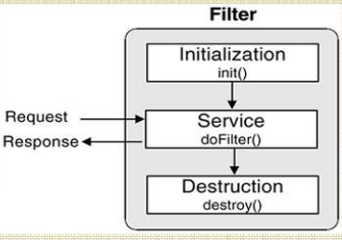
Filter Lifecycle & methods of Filter Interface
void init(FilterConfig filterConfig)
void doFilter(ServletRequest request, ServletResponse response, FilterChain chain)
destroy()

Slide 6
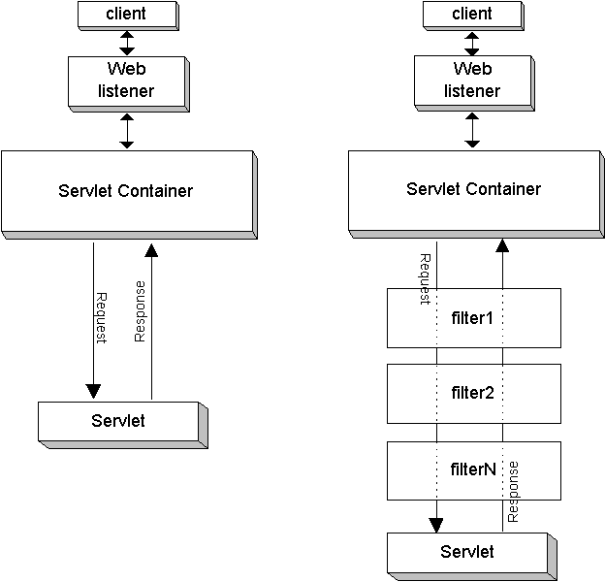
Filter Chaining

Slide 7
Filter Chaining
The FilterChain interface also specifies a doFilter(ServletRequest request, ServletResponse response, FilterChain chain) method, which takes a request and response pair as input and is used by each filter to invoke the next entity in the chain.

Slide 8
Filter Annotation
The @WebFilter annotation is used to declare a filter in a web application.
The annotated class must extend the javax.servlet.Filter interface.
Syntax
@WebFilter( attribute1=value1, attribute2=value2, …)
public class TheFilter implements javax.servlet.Filter {
// implements Filter's
}

Slide 9
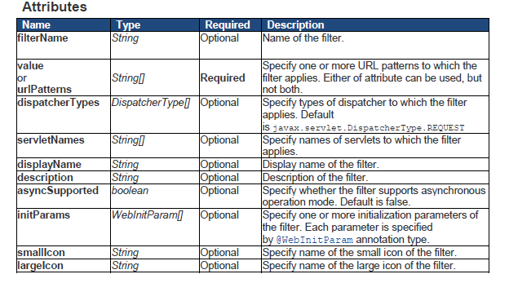
Filter Annotation

Slide 10


Copyright © 2019 Cybage Software Pvt. Ltd. All Rights Reserved. Cybage Confidential.
www.cybage.com

Slide 11


Thank You!
9/10/2019
www.cybage.com
Copyright © 2019 Cybage Software Pvt. Ltd. All Rights Reserved. Cybage Confidential.

